Slide 1
WEB & SOCIAL MEDIA ANALYTICS: CAPSTONE PROJECT
SUBMITTED BY:
MADHUVANTHI T
RAJESHWARI
SANTOSH KUMAR PAL

Slide 2
INTRODUCTION:
▶ With a growing trend towards digitization and prevalence of mobile phones and internet access, more consumers have an online presence and their opinions hold a good value for any product-based company, especially so for the B2C businesses. The industries are trying to fine-tune their strategies to suit the consumer needs, as the consumers leave some hints of their choices during their online presence.
▶ In the retail e-commerce world of online marketplace, where experiencing products are not feasible. Also, in today’s retail marketing world, there are so many new Phones are emerging every day. Therefore, customers need to rely largely on product reviews to make up their minds for better decision making on purchase. However, searching and comparing text reviews can be frustrating for users. Hence we need better numerical ratings system based on the reviews which will make customers purchase decision with ease.

Slide 3
Major Steps
Data collection,understanding,Preparation and EDA
Text Analysis
Modeling
Recommendation with help of Dashboard

Slide 4
GOAL:
▶ In this capstone project, we will be solving a problem in the mobile phone industry of the US, one of the major smartphones markets in the world.
▶ By analyzing the sentiment of the reviews, we can find the features of the phones that have resulted in positive/negative sentiments. This will help companies include or improve those particular features while developing a new product.
▶ Comparing the competitors' pricing and their market shares will help companies decide the price of their products.
▶ Before purchasing any product, we all look at similar products in various brands. This data will help the companies know their major competitors in the market.

Slide 5
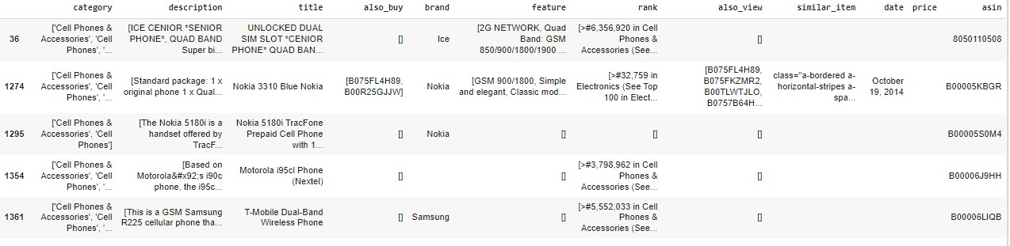
DATA COLLECTION:
1. Phone metadata: This data contains the product information and is independent of the consumer/reviewer activity and includes description, price, sales-rank, brand info, and co- purchasing links etc. The original data was in json format. The json was imported and decoded to convert json. The sample dataset is shown below:

Slide 6
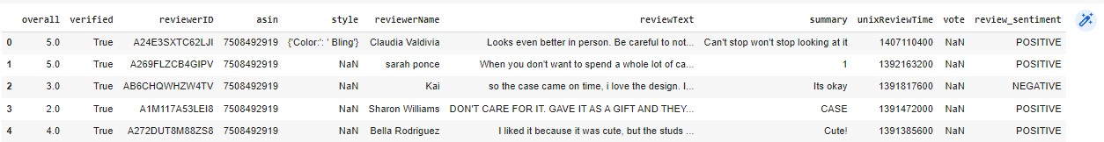
2. Phone data : This contains the consumer activity information. The sample dataset is shown below:

Slide 7
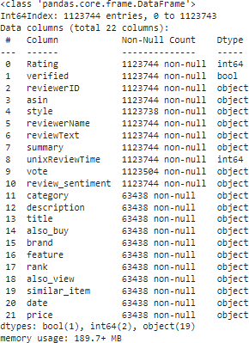
DATA WRANGLING:
▶ 1. MERGING DATAFRAMES: Phone Reviews And Meta Datasets In Json And Csv Files Were Saved In Different Dataframes And Two Dataframes Were Merged Together Using Left Join And “Asin” Was Kept As Common Merger. Final Merged Data Frame Description Is Shown Below:

Slide 8
2. We will be categorizing only Phone data for our analysis
3. Also we will segregating Phone data from the merged dataset by filtering Phone from title
4. Final phones dataset has 45562 row.

Slide 9
HANDLING DUPLICATES, MISSING VALUES:
34 Duplicate records from metaphone and 3452 from phone are dropped .
Image column has been dropped from Phone dataset.
Review, style,Summary,vote column having null values was filled by bfill method.
Summary and reviewText columns was merged and created a new column review_text. After that both the columns were dropped.
unixReviewTime was converted to datetime '%m %d %Y format and created a new column Date&Time.
By splitting Rating feature into good and bad rating we have creating new feature rating class.

Slide 10
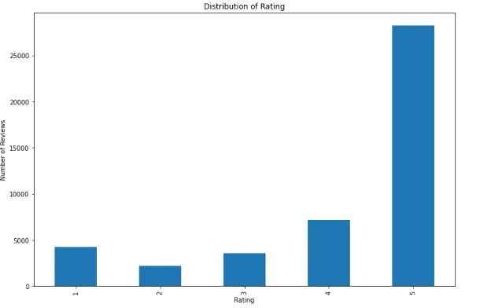
Rating Distribution
▶ We have see 25K+ people have given 5 rating which is overall highest.

Slide 11
DESCRIPTIVE STATISTIC SUMMARY:
▶ 25213 customer gives ratings and mean of the ratings is 4.1, which means that customers prefer to give high ratings for products. To be able to predict the ratings reasonably, we classified them as 'good' and 'bad' above.
▶ According to the statistics on rating stars:
▶ 4246 customers give 1 star
▶ 2178 customers give 2 stars
▶ 3565 customers give 3 stars
▶ 7202 customers give 4 stars
▶ 28229 customers give 5 stars
▶ 6424 customers give bad ratings
▶ 38996 customers give good ratings

Slide 12
PREPROCESSING TEXT: TEXT ANALYTICS
▶ Text is the most unstructured form of all the available data, various types of noise are present in it and the data is not readily analyzable without any pre-processing. The entire process of cleaning and standardization of text, making it noise-free and ready for analysis is known as text preprocessing.
1.
Accented characters/letters were converted and standardized into ASCII characters.
2.
Shortened versions of existing words are created
3.
Text Normalisation
4.
Lemmatization
5.
Removing stopwords
6.
Building a Text Normalizer

Slide 13
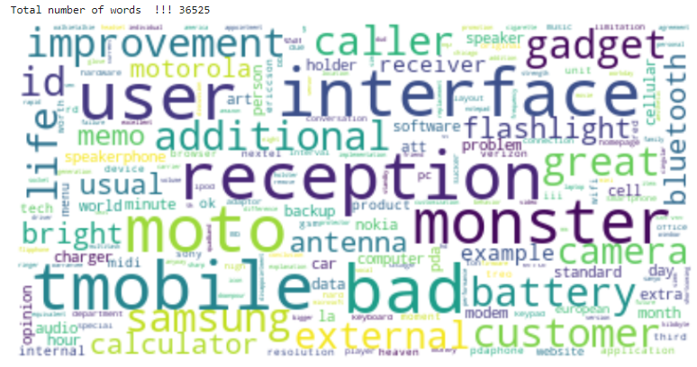
As a result of that, we had 36525 words in total. After completing all data wrangling and preprocessing phases, we save the dataframe to csv file as a ‘clean_text.csv. After cleaning, we have 45420 observations.
We have used wordcloud package to visualize the cleaned data.

Slide 14
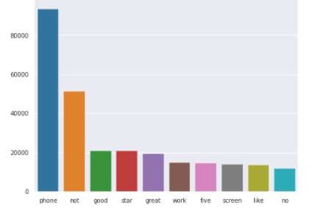
9. AS IDENTIFIED PHONE HAS BEEN THE MOST POPULAR WORD IN THE DATASET.

Slide 15
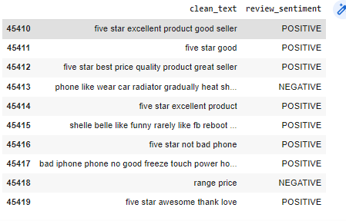
SENTIMENTAL ANALYSIS
▶ For Sentimenal Analysis we have used only sentiment review and clean text column.
▶ Now we have a cleandata dataframe as below:

Slide 16


▶ SPLITING THE DATASET INTO TRAIN AND TEST SET
▶ Train_pos and train_neg as used for checking positive and negative review.
▶ We have separated the Positive and Negative comments of the training set and removed the stop words. Now they were ready for a WordCloud visualization which shows only the most emphatic words of the Positive and Negative review.

Slide 17
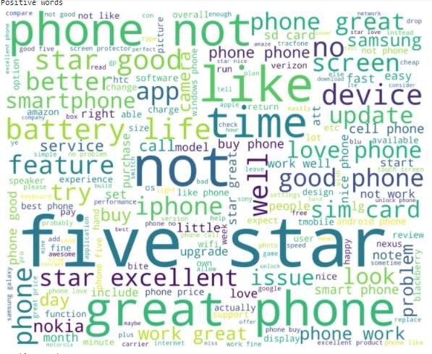
▶ POSITIVE WORD SET: GOOD, STAR, GREAT, LOOK, LOVE

Slide 18
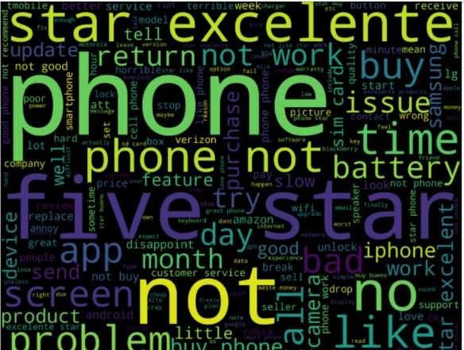
▶ NEGATIVE WORD SET: BAD, PROBLEM, NOT, RETURN, ISSUE, REPLACE, PHONE

Slide 19
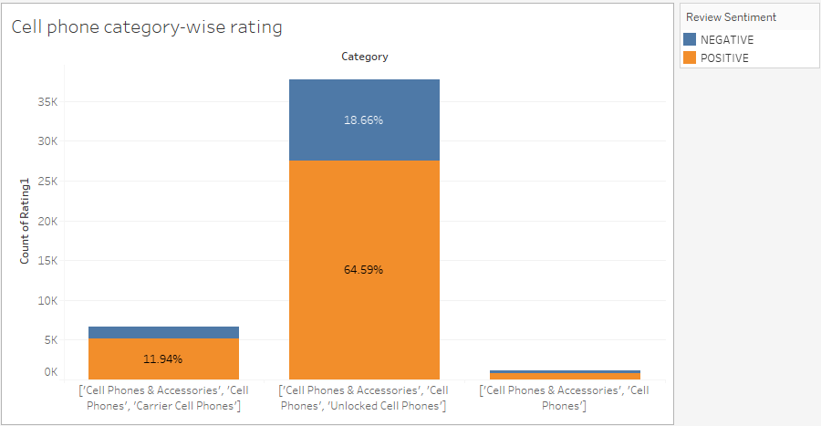
EXPLORATORY DATA ANALYSIS (EDA):
▶ After collecting data, wrangling data then exploratory analyses were carried out. The
following insights were explored through exploratory analyses.
▶ Unlocked Cell Phones are seems to be most likely used by customer having 64.59% positive reviews of the total number of reviews.

Slide 20
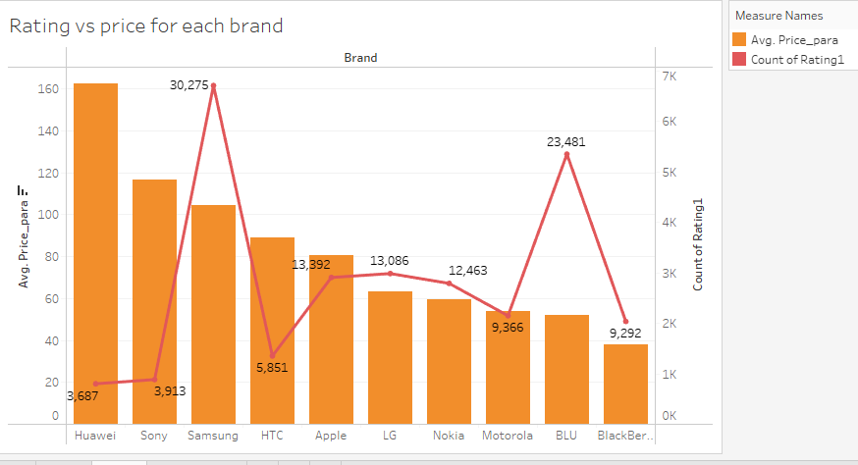
▶ Samsung is the top most brand likely used by customer having a highest positive reviews and also it’s competitor is BLU having not much difference in terms of positive review. Also Apple, LG and Nokia are the next Rivals companies of Samsung having almost same number of positive comments from the customer

Slide 21
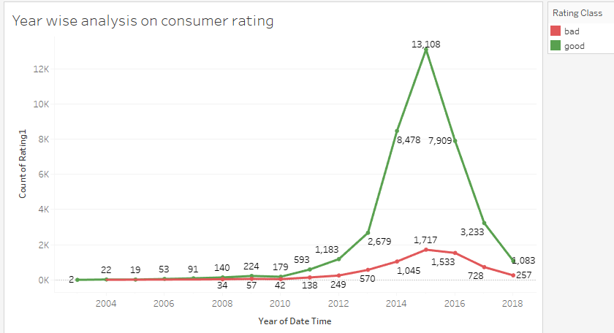
▶ If we have a look on the yearly stats in terms of reviews, we can observe after 2012 people are likely most interested in giving reviews(bad or good) to their purchased items and seems there is sudden increase in the number of comments in 2015 around 14k + in total.
▶ This might be because people are more aware of power and benefits of reviews.

Slide 22
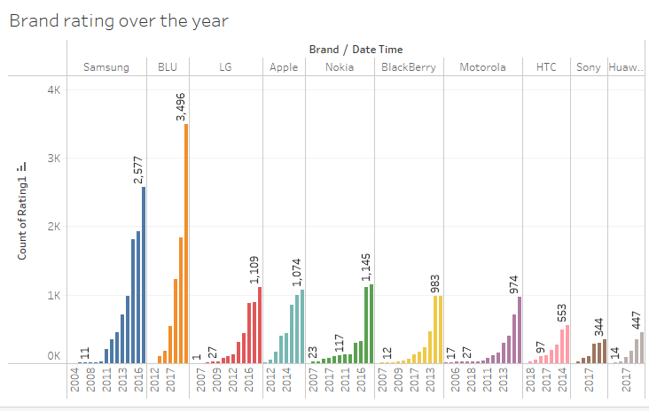
▶ Top 10 brand Yearly Review Stats

Slide 23
MACHINE LEARNING MODEL:
▶ In this project, the model needs to predict sentiment based on the reviews written by customers who bought phones. This is a supervised binary classification problem. Python’s Scikit libraries was used to solve this problem. We have used Naive Bayes machine learning algorithms for modelling.
▶ Naive Bayes implements the naive Bayes algorithm for multinomial distributed data, and is one of the two classic naive Bayes variants used in text classification (where the data are typically represented as word vector counts). This algorithm is a special case of the popular naïve Bayes algorithm, which is used specifically for prediction and classification tasks where we have more than two classes.

Slide 24
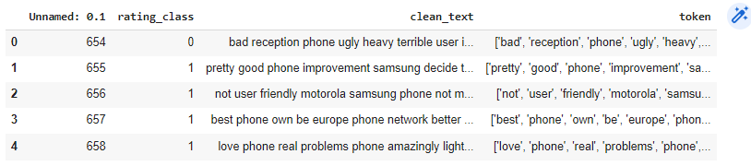
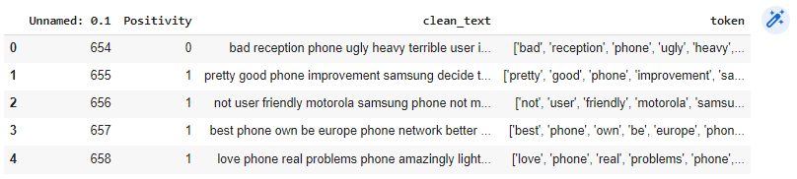
▶ BEFORE SPLITTING DATA INTO TRAIN AND TEST DATASET WE HAVE DROPPED ALL UNNECESSARY COLUMN WHICH ARE NOT GOING TO BE USED IN OUR ALGO.
▶ Below is review of new dataset formed having only rating_class and clean text.
▶ Later rating_class was re-named to Positivity
▶

Slide 25
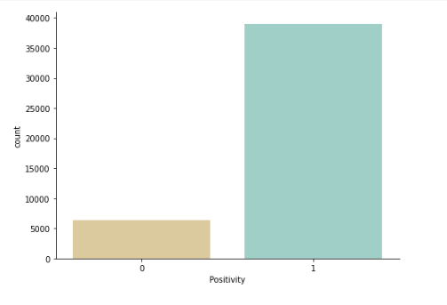
▶ THE BAR CHAT BELOW SHOWING A COMPARISON BETWEEN POSITIVE AND NEGATIVE REVIEWS USING PHONE DATASET

Slide 26
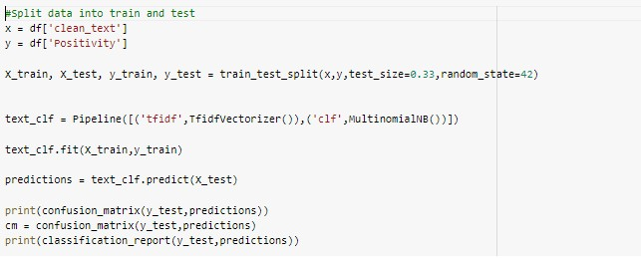
▶ Spliting dataset set into train and test and using MultinomialNB... Naive Bayes
classifier for multinomial models.

Slide 27
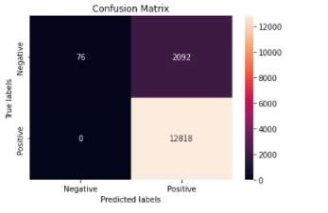
CONFUSION MATRIX
▶ True Positives (TP) : In our dataset 12818 are the correctly predicted positive review which means that the value of actual class is yes and the value of predicted class is also yes.
▶ False Positives (FP) :When actual class is no and predicted class is yes. Here we have a total of 2092 FP review
▶ True Negatives (TN) :These are the correctly predicted negative values which means that the value of actual class is no and value of predicted class is also no. We have 76 reviews which are correctly predicted as negative.
▶ False Negatives (FN) – When actual class is yes but predicted class in no. We don’t have any review which predicted as
negative though in actual it is positive.

Slide 28
Observation
▶ Accuracy : We got an accuracy of ~86% on the test set.
Accuracy = TP+TN/TP+FP+FN+TN
▶ Precision : Positive review has a precision of 86%.
Precision = TP/TP+FP
▶ Recall (Sensitivity) : Recall for positive review is 1.
Recall = TP/TP+FN
▶ F1 score : We got f1 score of 92% for positive review.
F1 Score = 2*(Recall * Precision) / (Recall + Precision)
This model predicts the sentiments of customer review with 86% level of accuracy.

Slide 29
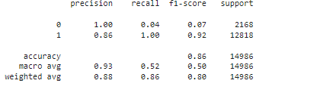
▶ Weighted average scores:
The sum of the scores of all classes after multiplying their respective class proportions.
▶ It is the simple mean of scores of all classes. So, macro average so, macro average recall is the mean of the recalls of all the classes.

Slide 30
FUTURE STUDY:
▶ Using different methods in order to minimize the effect of the
matching words
▶ Using different AutoML tools.
▶ Implementation of Dask library for parallel processing to decrease run
time.
▶ Using different ML Algo for comparing runtime

Slide 31
THANK YOU

Slide 32
GOOGLE DRIVE LINK
▶ https://drive.google.com/drive/folders/11w7zYF313xgjQaLcPY2kAmjVmgcvw
HPz?usp=sharing

